Slide 1
Fid’Lin: The Fiddle and Violin Practice App
Team 2
Jakob Beckleheimer, Dylan Brownell, Tanner Groll, Derek Pendleton, & Phil Snider

Slide 2
Description
A functioning mobile app in which its purpose is to assist the user in various ways with the fiddle or violin. It allows the user to create a profile and keep up with progression on learning their instrument. It additionally helps the player tune their instrument by recording the pitch of the instrument and notifying the user to tune the instrument to a higher or lower pitch. This app also helps the user learn basic scales and keeps up with tempo using a metronome.

Slide 3
Requirements
User friendly menu
Personal profile keeps up with progress
Tuning assist
Assist with scales
Keeps up with tempo
Intonation assistance

Slide 4
Toolbox
Writing in C#
VS Community
Notes:
Derek will speak on this slide

Slide 5
Team 2’s Communication medium
Trello
Github
Discord
Notes:
Derek will speak on this slide

Slide 6
Content Distribution Plan
Github is the primary location where source control will occur
All active working code and documents will be stored here.
Every week a zip file of the full Github repo will be deposited in Blackboard
Notes:
Derek will speak on this slide

Slide 7
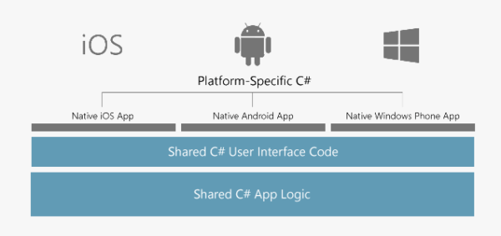
General Dev Plan
Image Source: https://visualstudio.microsoft.com/xamarin/.
Notes:
Derek will speak on this slide:
The general plan will be outlined here. We plan to first build the shared backend code as well as the shared user interface. Once that is finished, we will build the platform specific C# code.

Slide 8
Documents

